Slide 1

Day 1, part 1 - Basics
ITG DATAHUB ST
Paris, September 23rd, 2019

Slide 2
Agenda
1
Hadoop
HADOOP cluster : presentation
HDFS
Distributed workload
2
Dataiku
Dataiku DSS: presentation
Functionalities of Dataiku
Our Team
Best Practices
3
TUTORIAL

Slide 3
Hadoop
1

Slide 4









Hadoop cluster
relays on a distributed infrastructure called a « Cluster » (network of n servers).
A cluster is made of several kind of nodes, each of them set up with a Hadoop distribution :
The Edge Node is the link between the cluster and the outside world. Applications that leverage the cluster are installed here (Dataiku included).
The Master Node manages the distribution of data blocs and work loads on the data nodes / workers.
The Data Node ou Worker gèrent is in charge of the storage of data blocs and / or the calculations.

Slide 5
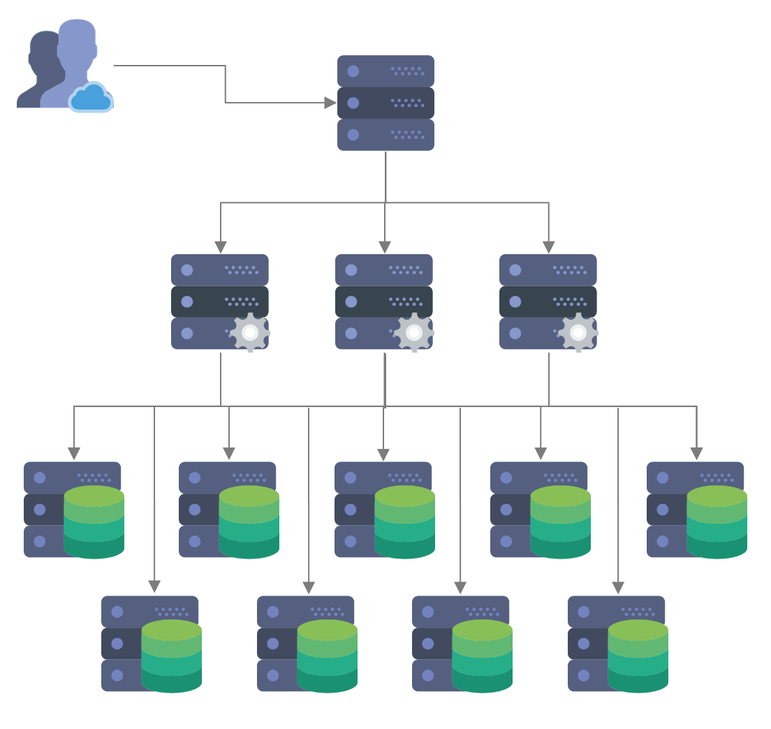

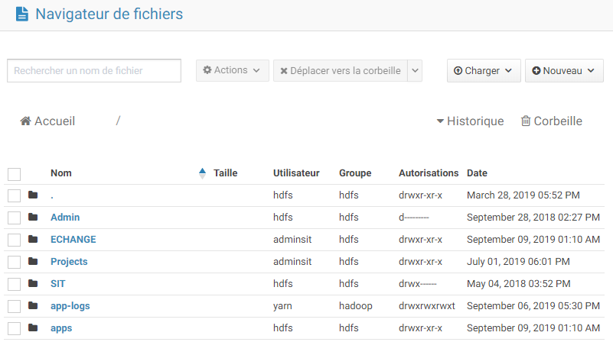
HDFS : Hadoop Distributed File System (1/2)
is the Hadoop file system : Hadoop Distributed File System
HDFS manages the data organization inside the cluster, transparently for the end user. It renders a logical view of the data, viewed as a single file system, even thought the data is physically distributed on all data nodes.
HDFS manages :
The sharding to optimize the access time. Files are cut in slices (or "shards") of lines, which are distributed on the data nodes. These shards are "horizontal partitions", as opposed to "vertical partitions" used in traditional relational DBMS.
The physical implantation of the data to take advantage of the data distribution.
The redundancy / replication of the data to fight potential hardware failure, and ensure the fiability and disponibility of the system (defaults to 3 time, but configurable)

Slide 6
HDFS : Hadoop Distributed File System (2/2)
Incoming file
Acquisition
Replication
Master
Node
A
A
A
File = A + B + C
A → DN1, DN3, DN4
B → DN3, DN2, DN6
C → DN2, DN5, DN6
Sharding
B
B
B
C
C
C
Implantation
DN1
DN2
DN3
DN4
DN5
DN6
Data
Nodes

Slide 7

Distributed processing
Query
Master
Node
Fichier = A + B + C
A → DN1, DN3, DN4
B → DN3, DN2, DN6
C → DN2, DN5, DN6
Process Parallelization
DN1
DN2
DN3
DN4
DN5
DN6
Data
Nodes
A
B
A
A
C
B
A’
C
B
C
C’
B’

Slide 8
Dataiku
2

Slide 9
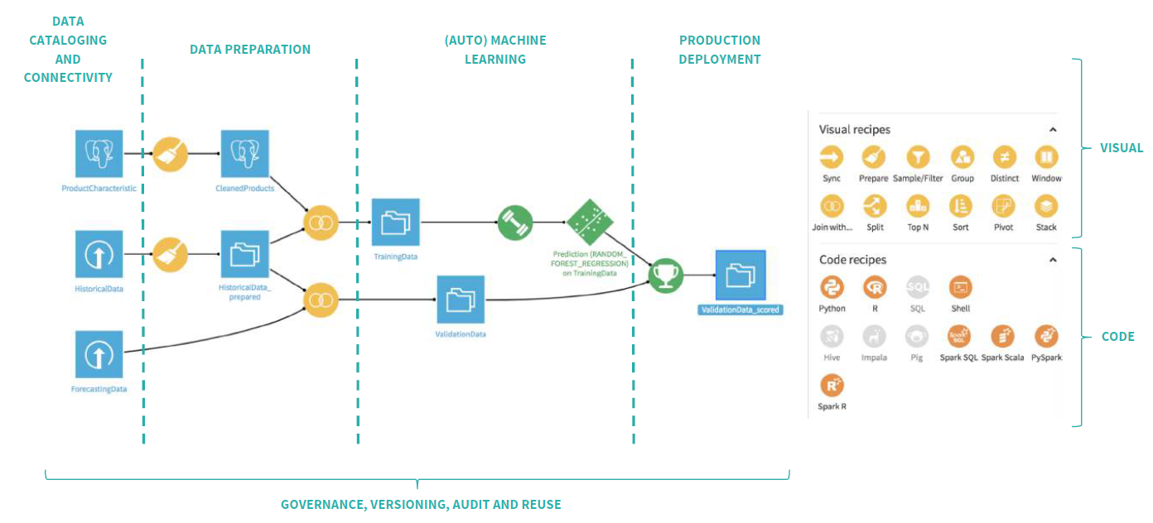
Dataiku DSS (1/2)
A collaborative platform of Data Science with different actors (Data Engineer, Business Analyst, Data Scientist)

Slide 10
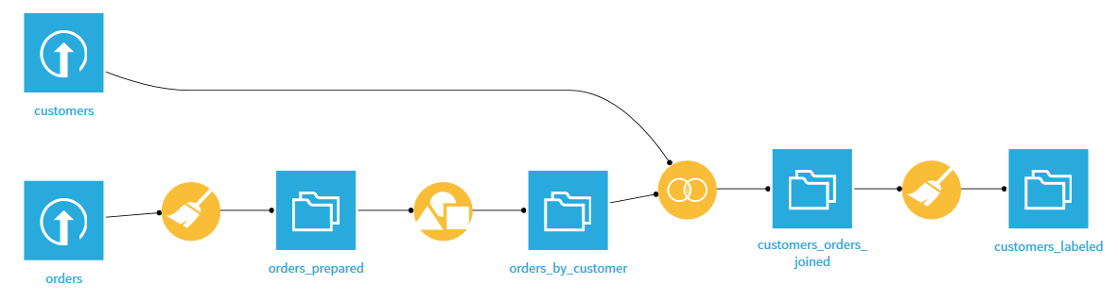
Dataiku DSS (2/2)
Dataiku DSS is organized by project :
Series of Datasets (data) and Recipes (processing)
- Different type of datasets (xlsx, csv, orc, …) in local or on the cluster (hdfs)
- Visual recipes (prepare, join with, split, sort, …) or code recipes (python, R, SQL, Shell, Spark, HQL,…)
Main functionalities on DSS:
- Collaborative : is suitable for coder (R, python, SQL, Spark, HQL, ..) and no-coder
- Connection to different data resources (Hadoop HDFS, Teradata, Oracle…)
- Automation of processing with scenarios
- Virtual Environment / Code-env on R or Python dedicated to your Use Case
- Presentation of data with dashboards
- Interactives discussions between users on the project
- History of changes with git
- Machine Learning facilities
- Wiki
- …

Slide 11
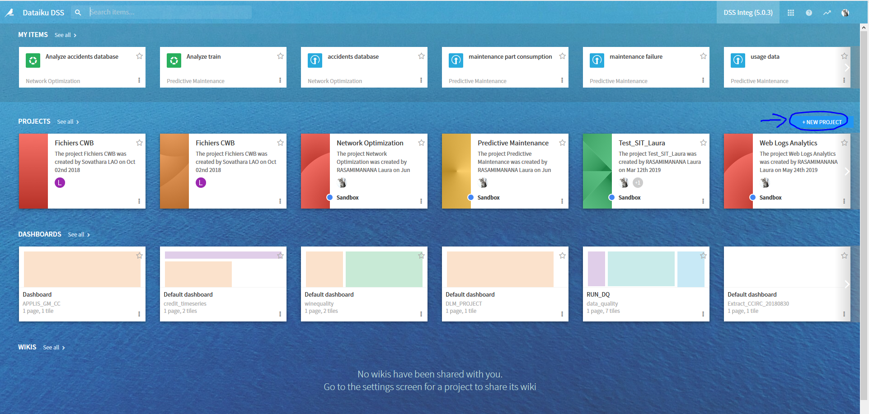
Functionalities of Dataiku DSS : Creation of a project
Creation of a project :
On the home page, click on + New Project
Once the project is created, get into the habit of adding tags plus a description of the project

Slide 12
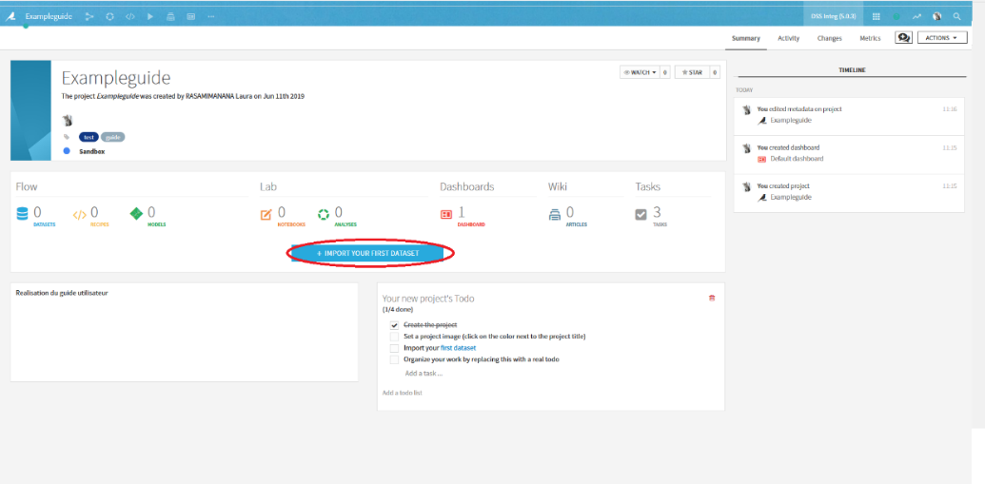
Functionalities of Dataiku DSS : Creation of a dataset
Creation of a dataset:
Step 1: Click on Import your first Dataset (for your first time) or Go to your flow and click on +dataset
Step 2: Several files type is suggested. /!\ If you upload a file from your computer, remember to fill the case store on.
Step 3: With the Preview tab, you have an overview of your data just as the schema that you can modifu if it is not correct.
Step 4: Click on create and you can have access to your dataset with Explore

Slide 13
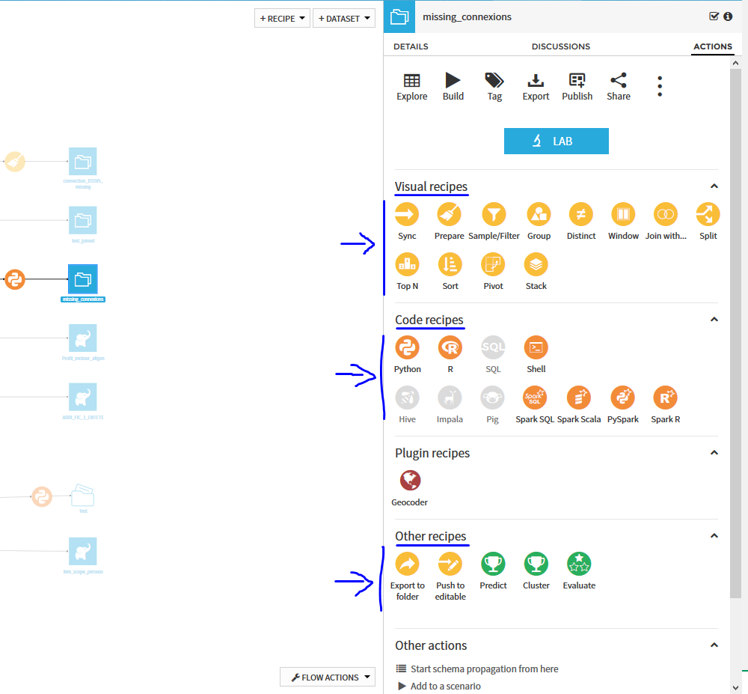
Functionalities of Dataiku DSS : Creation of a recipe
Creation of a dataset:
Step 1: Go to the flow of your project. It redraws the historic of all the datasets and recipes created.
Step 2: Click on the created dataset. You will see on the right the different kind of recipes. You could choose between a visual or code recipe.

Slide 14
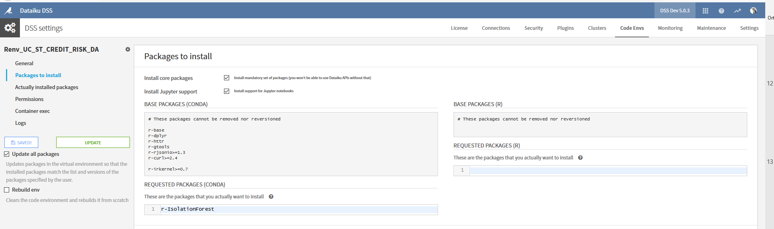
Functionalities of Dataiku DSS : Code Env
A code env is a standalone and self-contained environment to run Python or R code where you can create your own library and install different packages without asking us.
Step 1: The owner of the code env can manage the access to it. If you have no access ask the owner to give you the access
Step 2: If you wan to install new packages, go to Administration > Code Envs > Code_Env_Name > Packages to install. You can use the code env with a notebook (Kernel > change Kernel > Code_Env_Name)

Slide 15

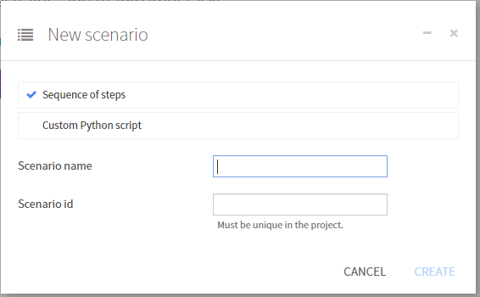
Functionalities of Dataiku DSS : Scenario
2 types of scenario:
Step-based scenario: it is a list of steps that you will predefine. Each time that your scenario is launched, each step of it will be run and in the same order.
Custom python scenario : It is a script python that you develop and it will be run in an environment allowing it to launch scenario steps on the DSS backend.
To create a scenario, go to your project then click on . On the pull-down menu click on Scenarios. Then you click on + NEW SCENARIO and you will be able to choose the type of your scenario as you can see on the following picture.

Slide 16
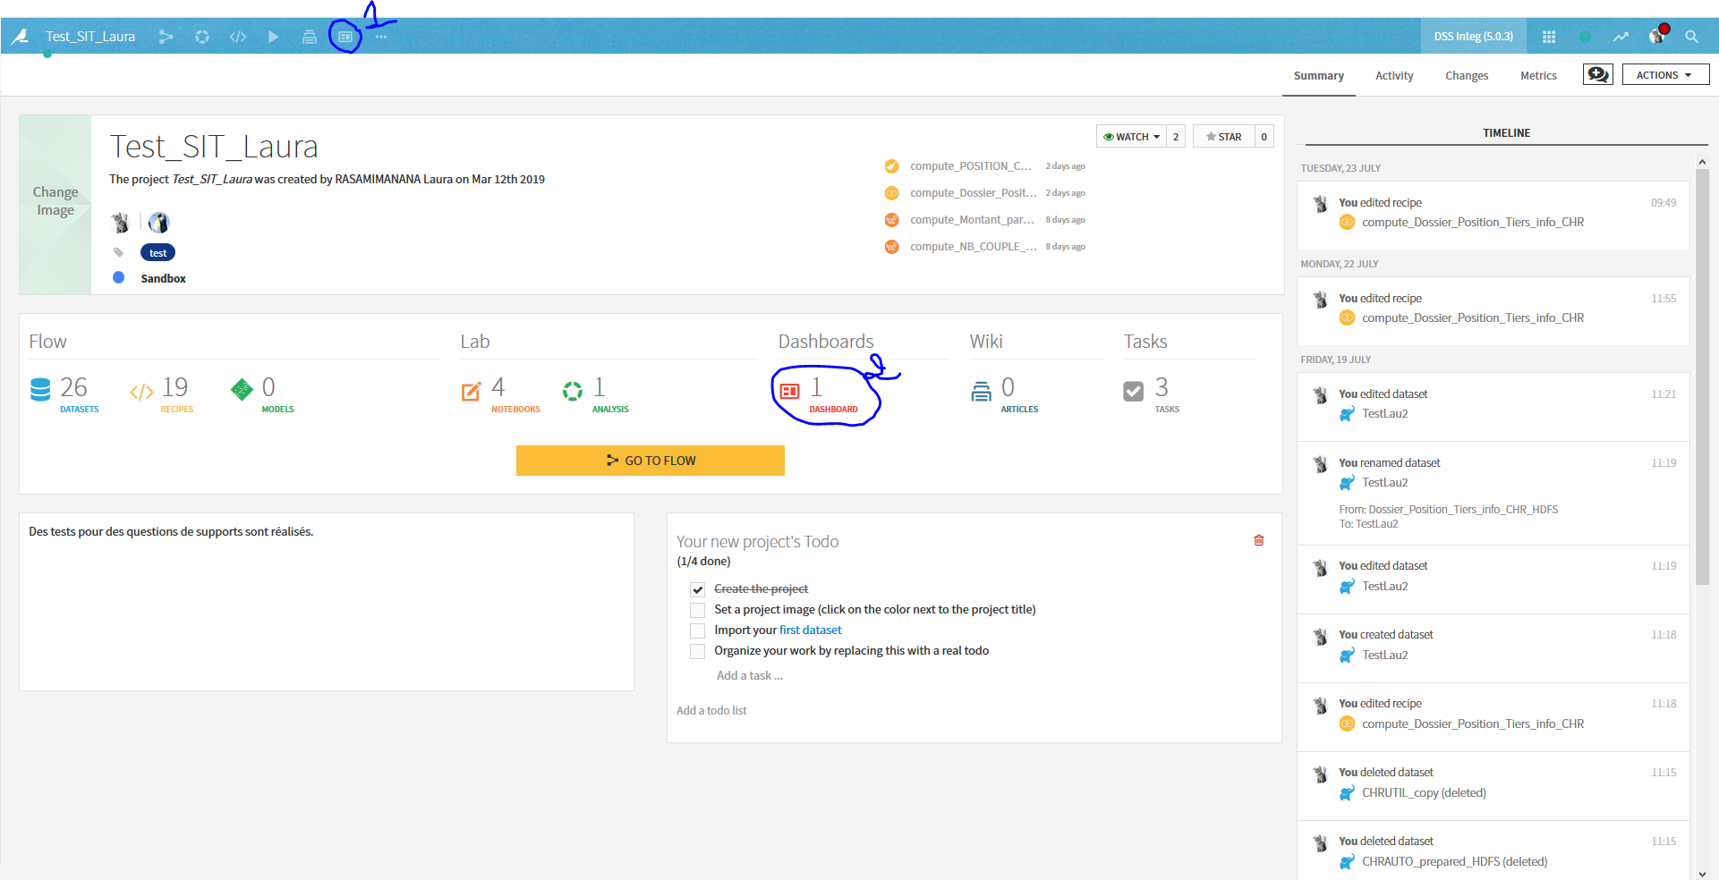
Functionalities of Dataiku DSS : Dashboard
By default a dashboard is created with your project. With this dashboard you can realize reporting for example or share elements of your project with ither memebers of your team.
2 types of tiles:
Simple tile which can contain a text or images for example
Insight tile that can be a tabular representation of a daatset, a graph, the metrics of DSS, the export of a Jupyter notebook, etc.
To create another dashboars on your project, there are 2 ways:
Possibility 1: Click on the element 1 of the screenshot and then select Dashboard
Possibility 2: Click on the element 2

Slide 17
Our team
Administration of 2 Hadoop clusters with Dataiku DSS installed for 40 Use Case
150 users : 1/3 on SITINT034 and 2/3 on DTHFGINT001
Direct contact with the production team of BNP Paribas (licenses, issues on the cluster) and the software company Dataiku (support)
Support Dataiku DSS :
Functional support ► Accompaniment on Dataiku DSS and sharing the best practices (Wiki)
Technical support ► Maintenance of the technical environment Hadoop, Debugging your code (R, python, SQL, Hive, Spark, accompaniment

Slide 18
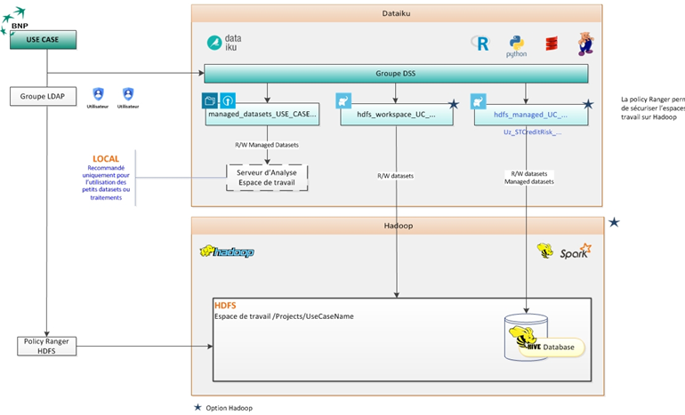
Best Practices: Storage
3 type of connections are available for each Use Case:
managed_datasets : local connection (to use for small files)
hdfs_workspace : connection on HDFS files of the cluster
hdfs_managed : connection to the Hive database

Slide 19
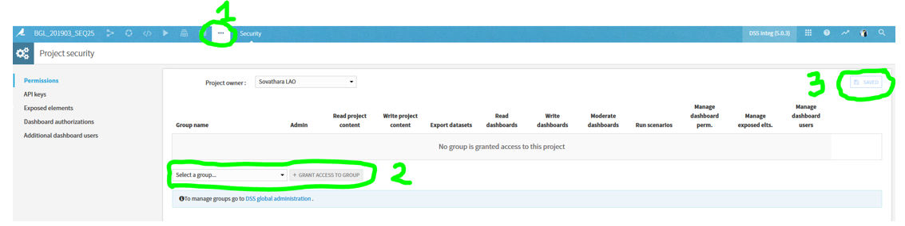
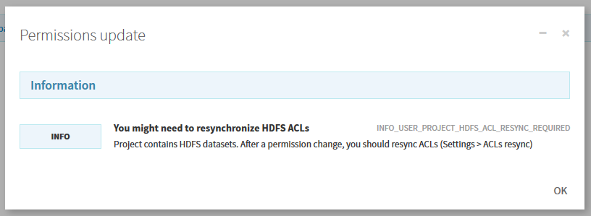
Best Practices: Sharing project
Caution a project with more than 300 datasets, is difficult to read and will not be handled by our team if you encounter issue.
Access to a project given by the owner:
Step 1: … > Security
Step 2: Select a group > + GRANT ACCESS TO GROUP (Pay attention to the right you are given)
Step 3: SAVE
Step 4: They might ask you to resync ACLs. Go to … > Settings > ACLs resync
Step 5: Click on Resync HDFS ACLs

Slide 20
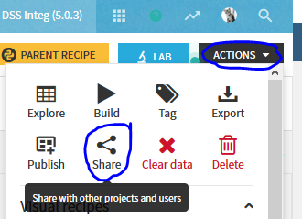
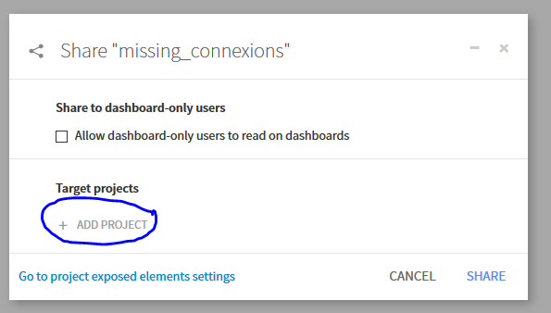
Best Practices: Sharing dataset
Prerequisite: the project should be shared with the group
Access to a dataset given by the owner of the project
Step 1: Click on the dataset you want to share.
Step 2: Actions > Share > + ADD PROJECT (you need to choose on which project the dataset can be shared)

Slide 21
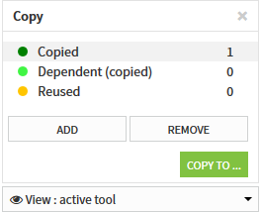
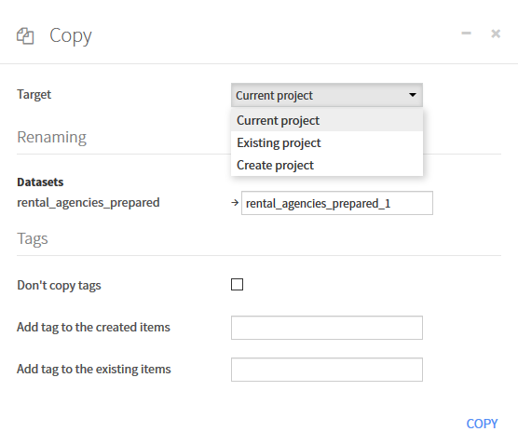
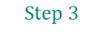

Best Practices: Copy of a project
It is possible to copy several steps of a project
Step 1: Select the wanted recipes (or dataset) of the flow (use shift or Maj to select several components) on the right of the window you will find Other actions > Copy
Step 2: On the pop-up window, click on ADD for the component that you want to copy or REMOVE to reuse the existed dataset.
Step 3: Choose the target: current project, existing project or create project. Then define the properties of your copy.
Step 4: Click on COPY (Do not forget to change the connection of your dataset to prevent a change of the original dataset)
$$Step 2$$
$$Step 3$$

Slide 22
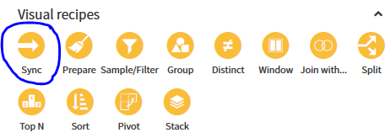
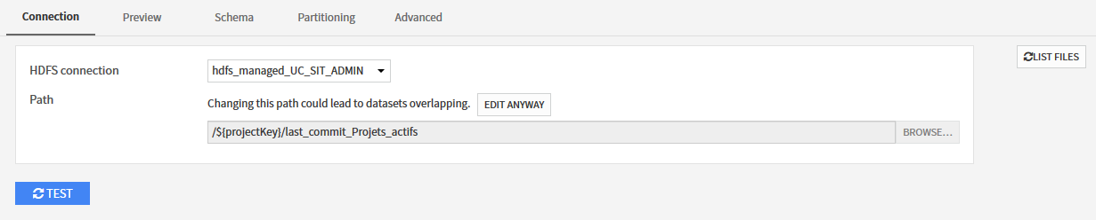
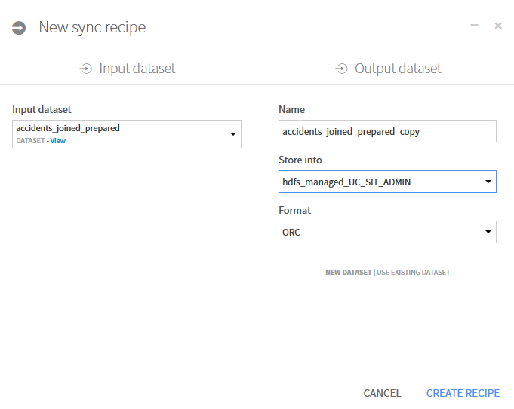
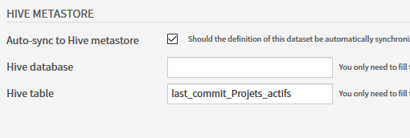


Best Practices : Change the connection of a dataset (1/2)
Prerequisite : The dataset should be in a format compatible with Hadoop. If it is not the case, please realize a synchronization of your dataset with the recipe Sync and choose an HDFS connection
Step 1: For the dataset which needs to be replace, go to Settings > Connection. Then choose the connection and the path of the new table.
Step 2: Modify the information about the Hive Metastore specifically the dataset Hive and the Hive table associated to the new table. (The Hive database is usually under the name uz_UseCaseName).
Prerequisite
$$Step 1$$
$$Step 2$$

Slide 23
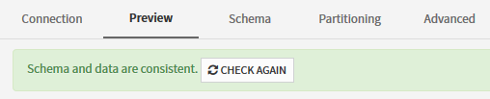
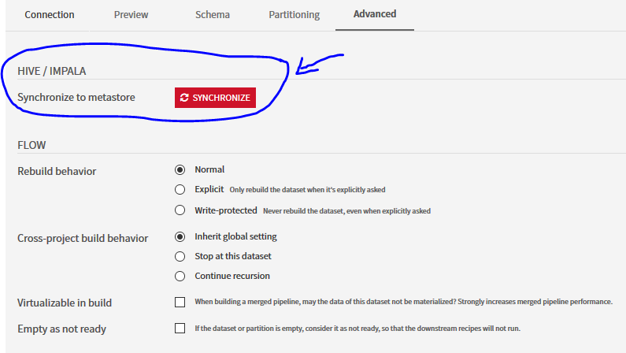


Best Practices : Change the connection of a dataset (2/2)
Step 3: Check the format on Settings > Preview is correct. Click on Tests to check the consistency of the schema. Then Save.
Step 4: Finally synchronize your dataset with the Hive metastore using the Advanced tab
Step 5: Rebuild your recipe.
$$Step 3$$
$$Step 4$$

Slide 24
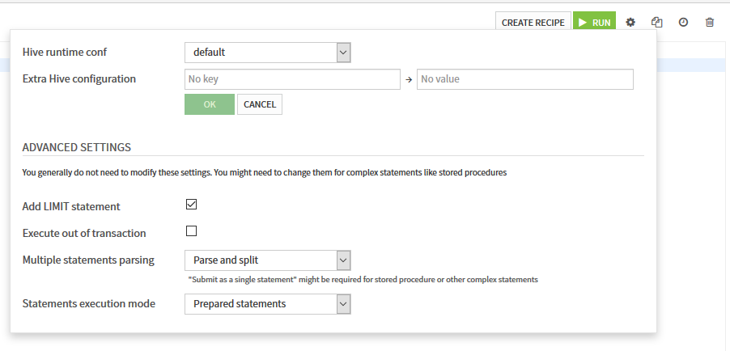
Best Practices : Export the whole lines from a Hive notebook
On a notebook the export of the result is limited to 1000 lines. To deactivate this limit, you need to click on the icon and uncheck Add LIMIT statement

Slide 25
TUTORIAL
3

Slide 26
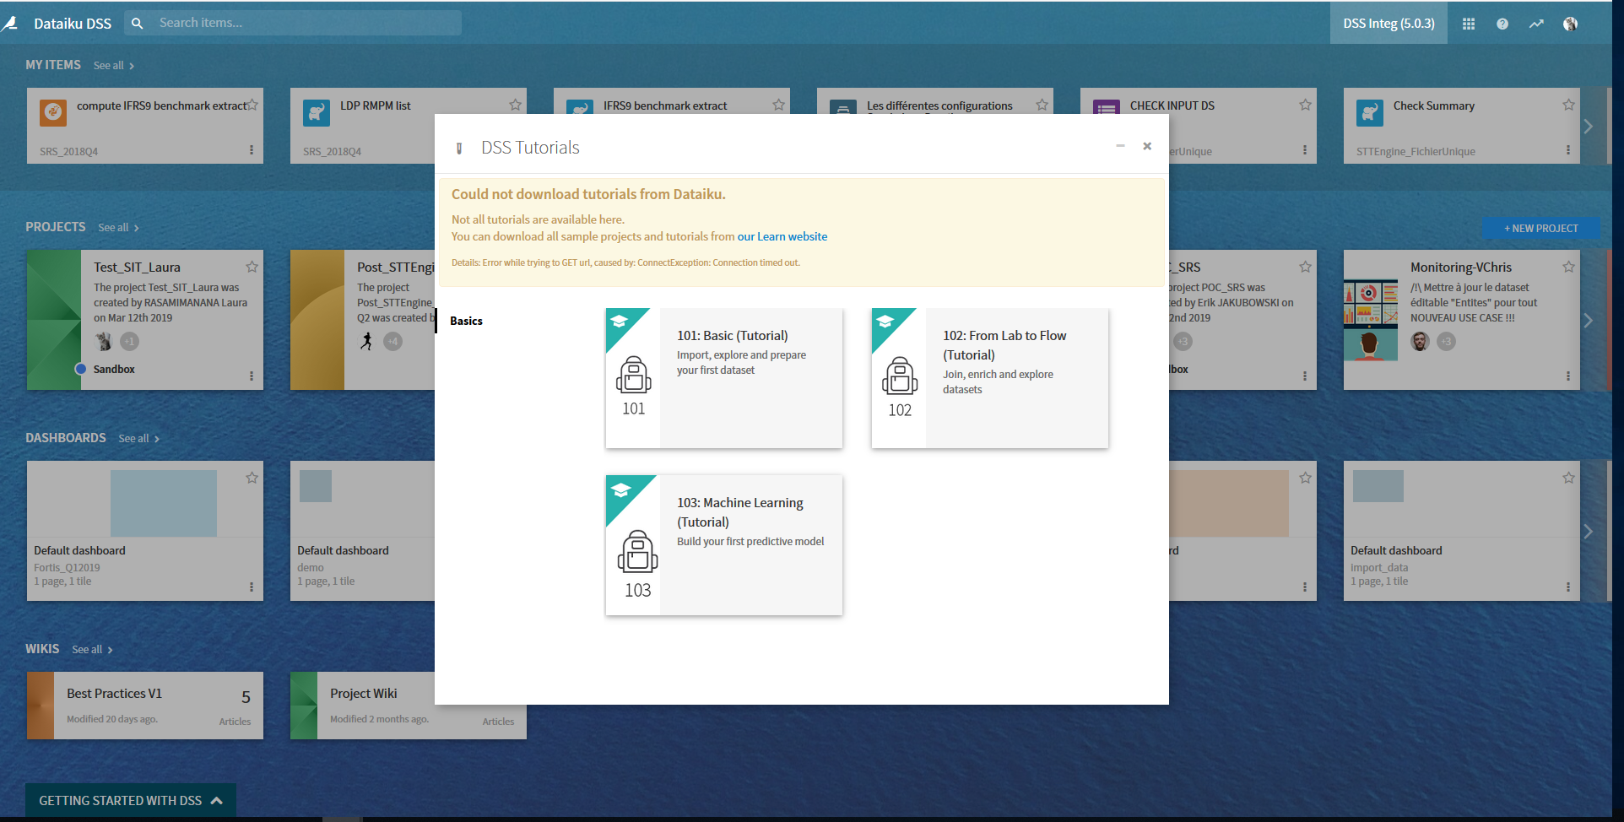
Tutorial Basics : Create Project
Prerequisites: downloading the orders CSV file
Create Your project:
Step 1: From the dataiku homepage click +New Project
Step 2: Select DSS Tutorials from the list dans select 101:Basic (Tutorial). It will create a new project and lands you on the project homepage

Slide 27
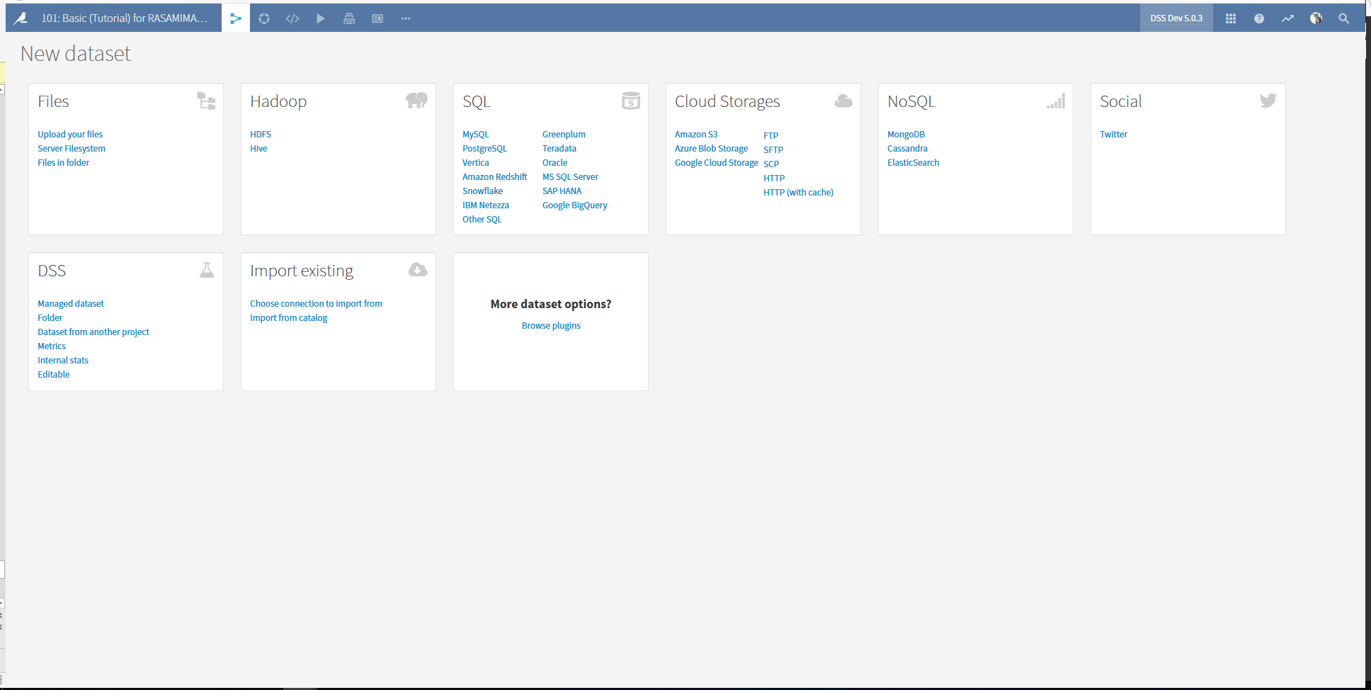
Tutorial Basics: Create Dataset (1/3)
Step 3: Let’s now load our first Dataset! In the project home click + Import your first dataset.
Step 4: Click on Upload your files. You are represented with the Upload dialog. Click on Add a file, select the orders.csv file you downloaded and validate. The file is uploaded.

Slide 28
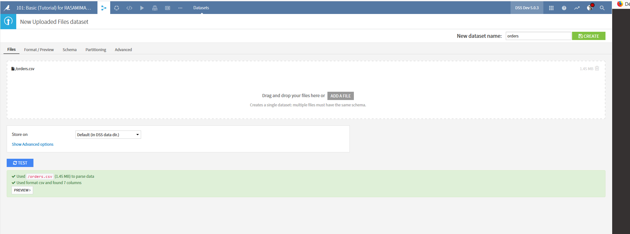
Tutorial Basics: Create Dataset (2/3)
Step 5: Let’s check if Dataiku DSS detected our CSV format correctly by clicking on the Preview button

Slide 29
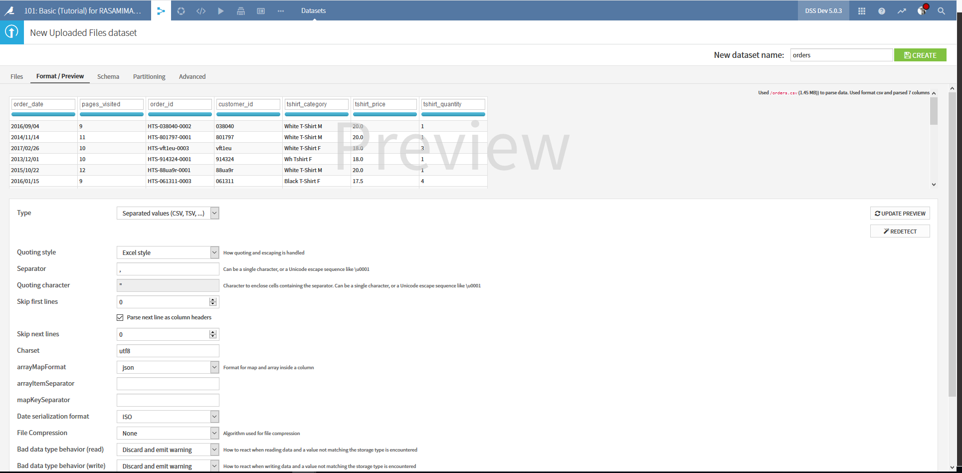
Tutorial Basics: Create Dataset (3/3)
It has automatically detected that the file has delimiter-separated values with a comma separator. You can notice the data is in a tabular format with columns and rows. Since it’s OK, save your work by hitting the create button. This creates the new dataset and lands you on the Explore page for the orders dataset.

Slide 30
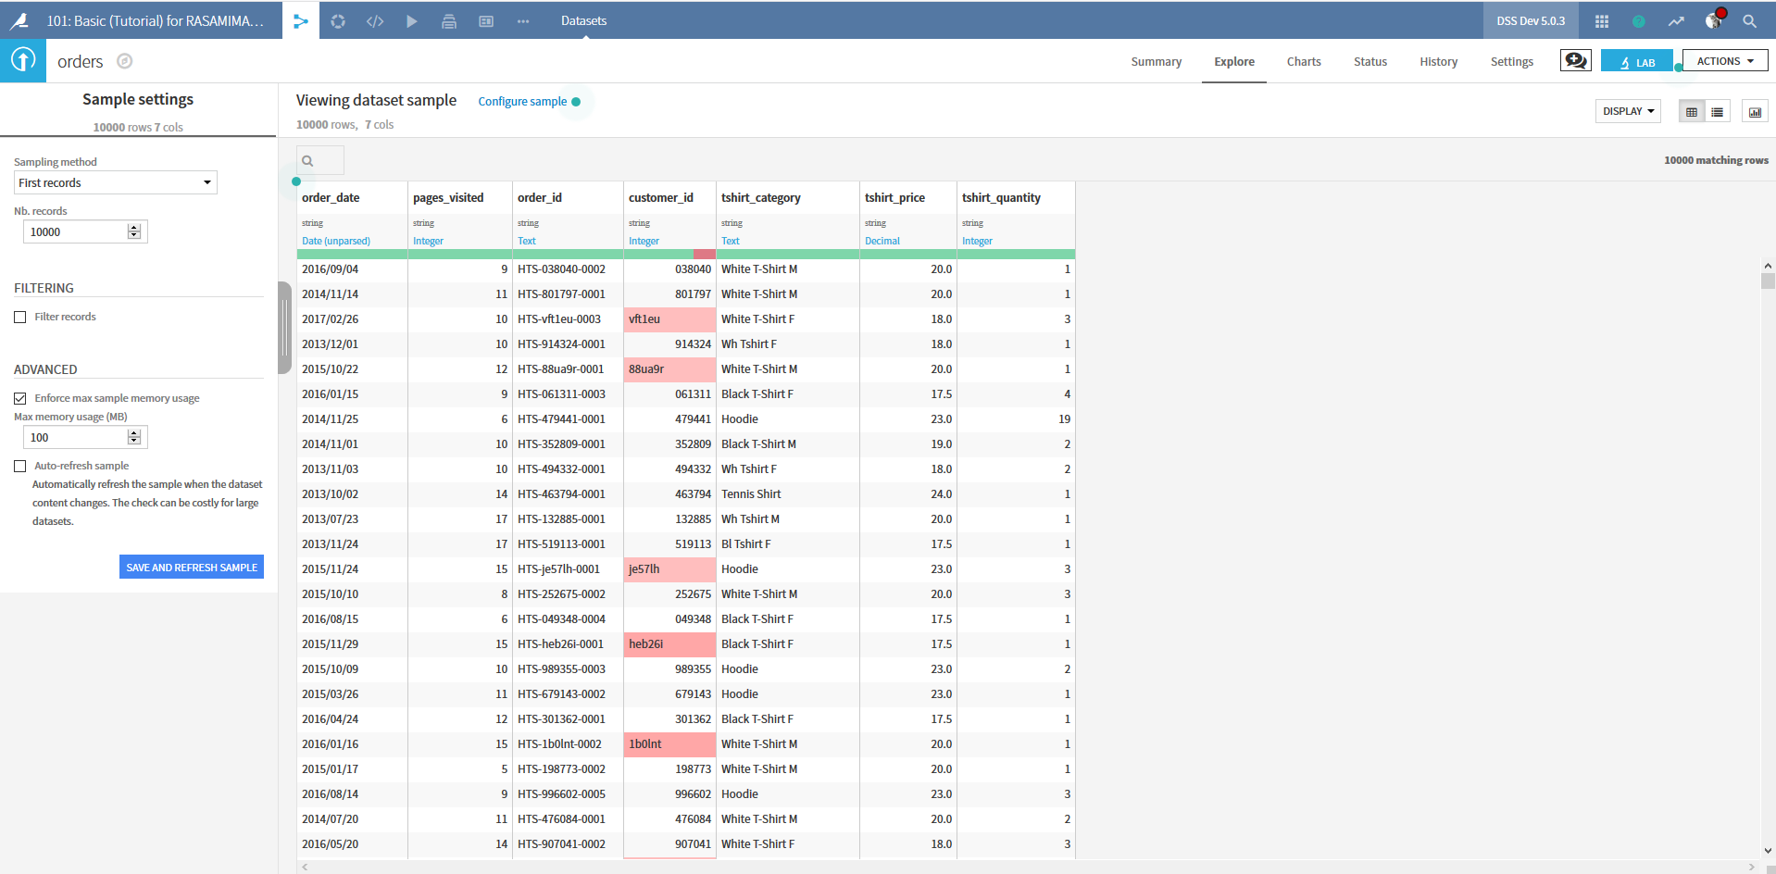
Tutorial Basics: Explore your data (1/4)
Sampling:
You can control the size of the sample and the sampling method. To see these settings, click on Configure sample, which opens a panel on the left

Slide 31
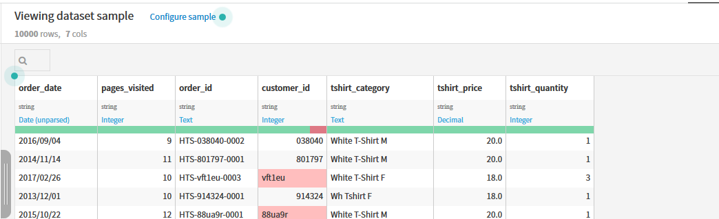
Tutorial Basics: Explore your data (2/4)
Storage Type and Meaning:
Each column is identified by name and has a storage type that indicates how the original data is stored (string, integer, decimal number, date…)
DSS detects a meaning in blue which is a « semantic » type that reflects the nature of the values of the column.
Below the meaning is a gauge that indicates the proportion of columns values that do not seem to match the meaning (red) or are completely missing (gray).

Slide 32
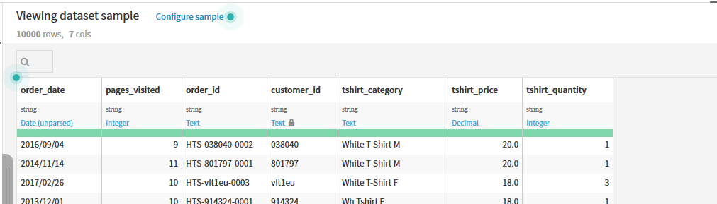
Tutorial Basics: Explore your data (3/4)
Storage Type and Meaning:
DSS detects a meaning of Integer for customer_id but has you can see a part of the gauge is red so for few values this meaning do not match. You can determine if these values are truly invalid or if it is too restrictive. In this case, it is integer is too restrictive meaning, click on the meaning and select Text to update it. Now the gauge should be entirely green.

Slide 33
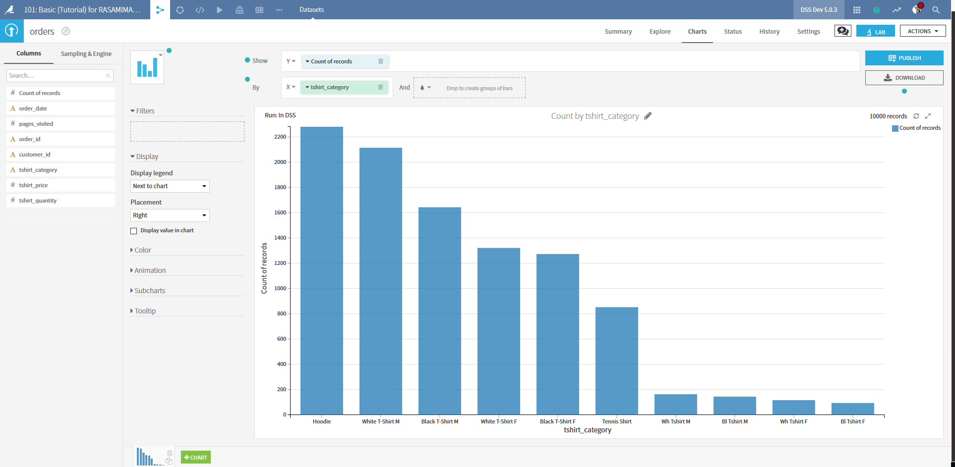
Tutorial Basics: Explore your data (4/4)
Charts:
You can use charts to explore the input dataset.
Click on the Charts tab
Drag and drop Count of records as the Y variable.
Drag and drop tshirt_category as the X variable.
Tshirt_category values are not consistently recorded. Let’s handle these issues by preparing the data with a recipe

Slide 34
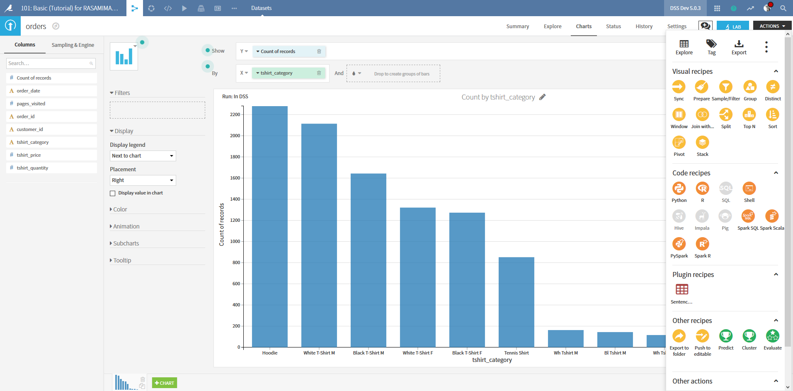
Tutorial Basics: Prepare Data with a Visual Recipe (1/9)
First Steps:
Click on the Actions button at the top right of the orders dataset and choose Prepare

Slide 35
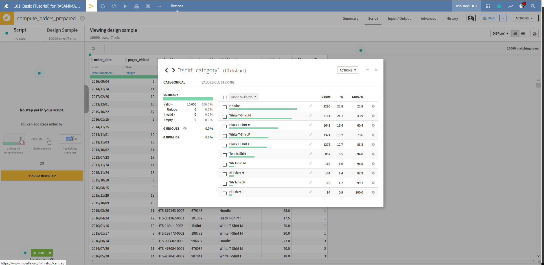
Tutorial Basics: Prepare Data with a Visual Recipe (2/9)
In order to standardize the coding of tshirt_category, we will recode the values. Click on the column name and select Analyze. The Analyze box opens and allows you to view a quick summary of the data in the column.

Slide 36
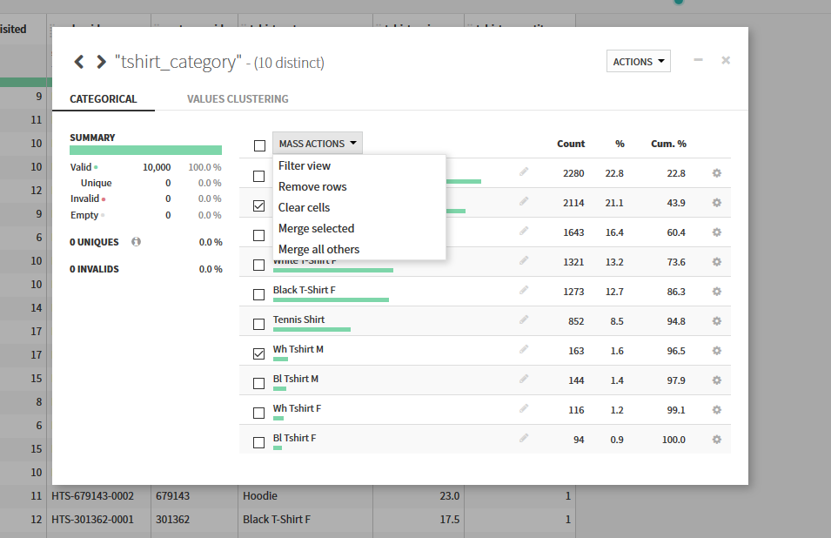
Tutorial Basics: Prepare Data with a Visual Recipe (3/9)
Select White T-Shirt M and Wh Tshirt M, and from the “Mass Actions” dropdown choose Merge selected. Choose to replace the values with White T-shirt M and click Merge. Repeat this process for other categories as needed

Slide 37
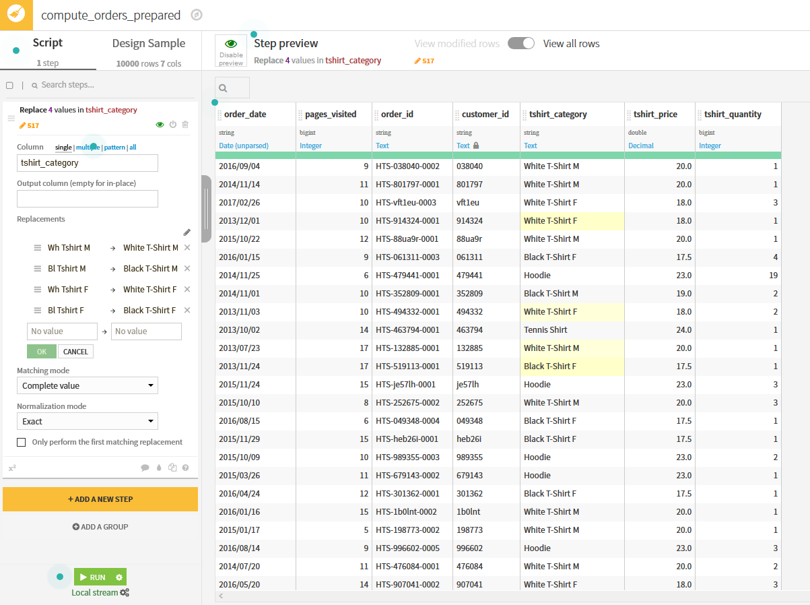
Tutorial Basics: Prepare Data with a Visual Recipe (4/9)
Close the Analyze dialog and see that a “Replace” step has been added to the Prepare script. You can create this step explicitly in the script, but the Analyze dialog provides a quick and intuitive shortcut to build the step

Slide 38
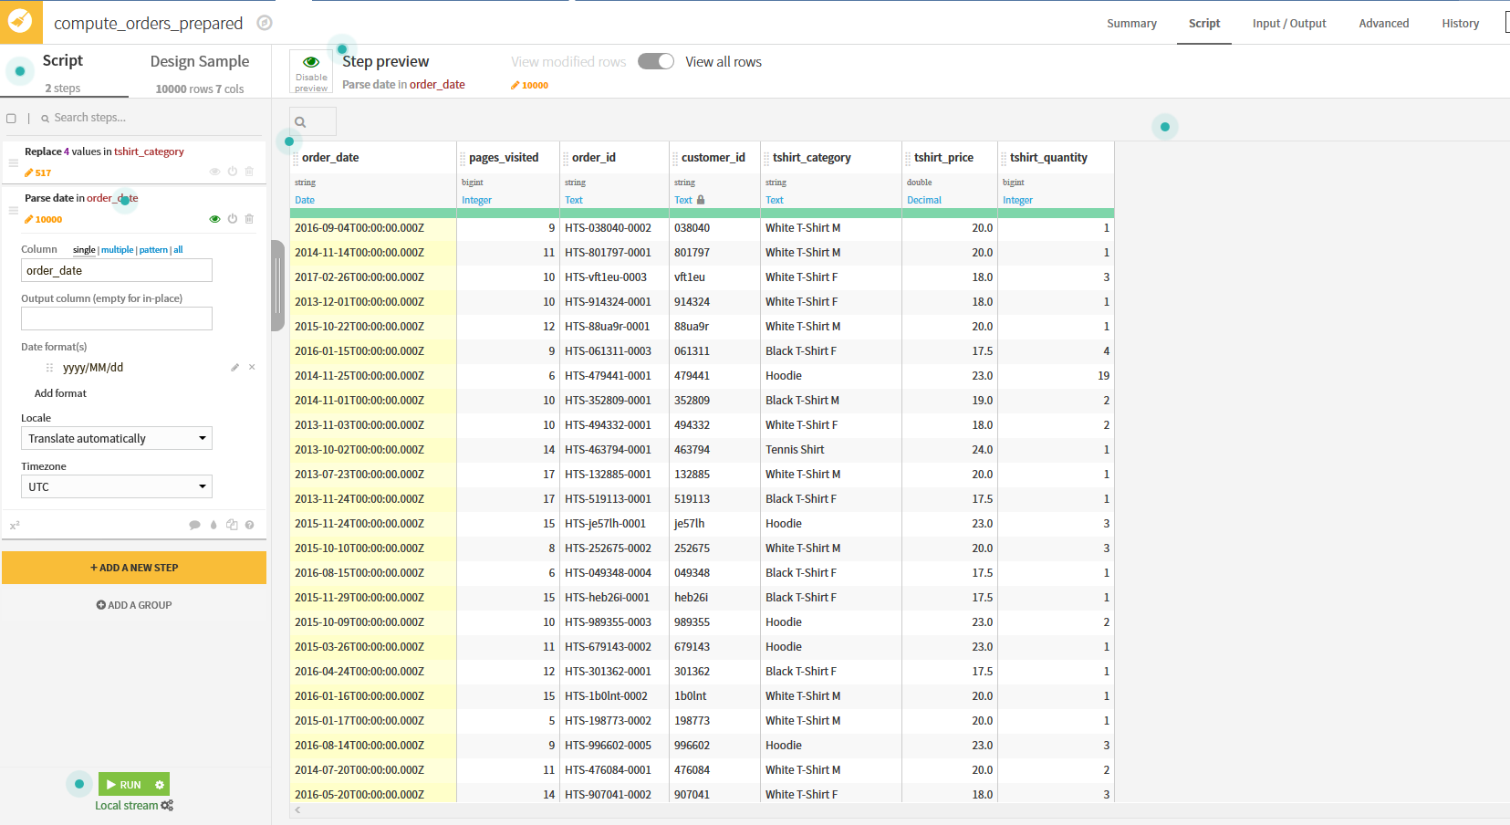
Tutorial Basics: Prepare Data with a Visual Recipe (5/9)
The input dates are unparsed and need to be processed if we want to use them. Open the column dropdown and select Parse date. The Smart Date dialog opens and shows the most likely formats for your dates. In our case, the dates appear to be in yyyy/MM/dd format. Select this format, click OK and a Parse date has been added to the Prepare Script and a new column order_date_parsed is created. Clear the output column text box in the script step, which has the effect of parsing dates in place.

Slide 39
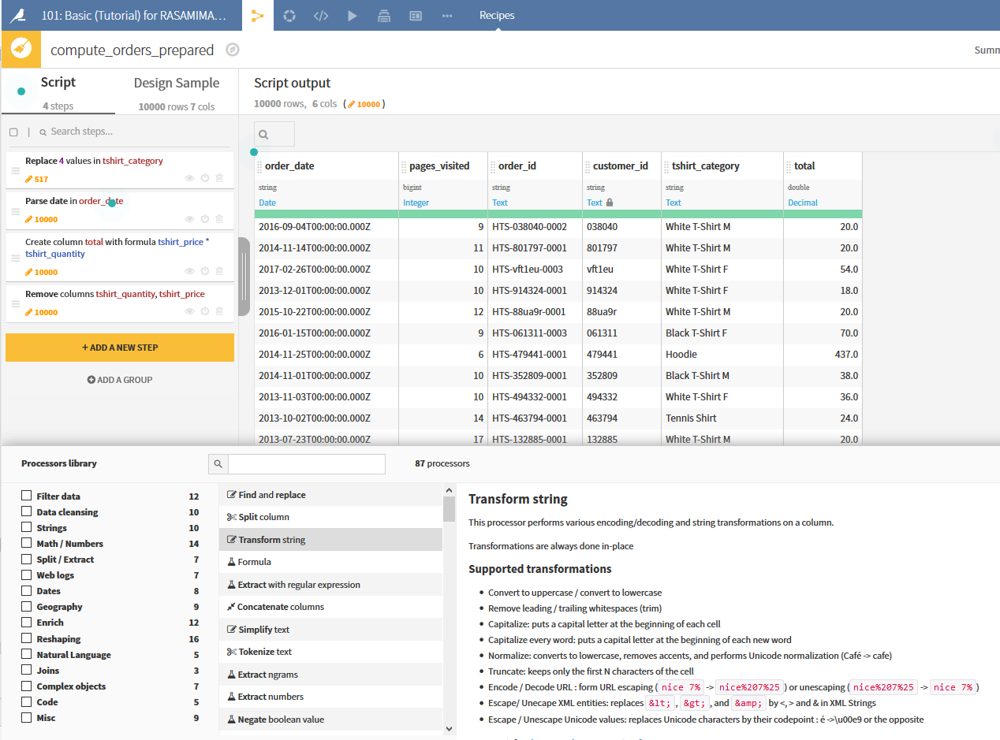
Tutorial Basics: Prepare Data with a Visual Recipe (6/9)
Let’s compute the value of each order. The orders dataset includes the number of t-shirt in each order and the price per t-shirt, but we want to know the total of each order so we can analyze it. We will use a Formula step.
Click on +Add a New Step button in the left bar
Select Formula

Slide 40
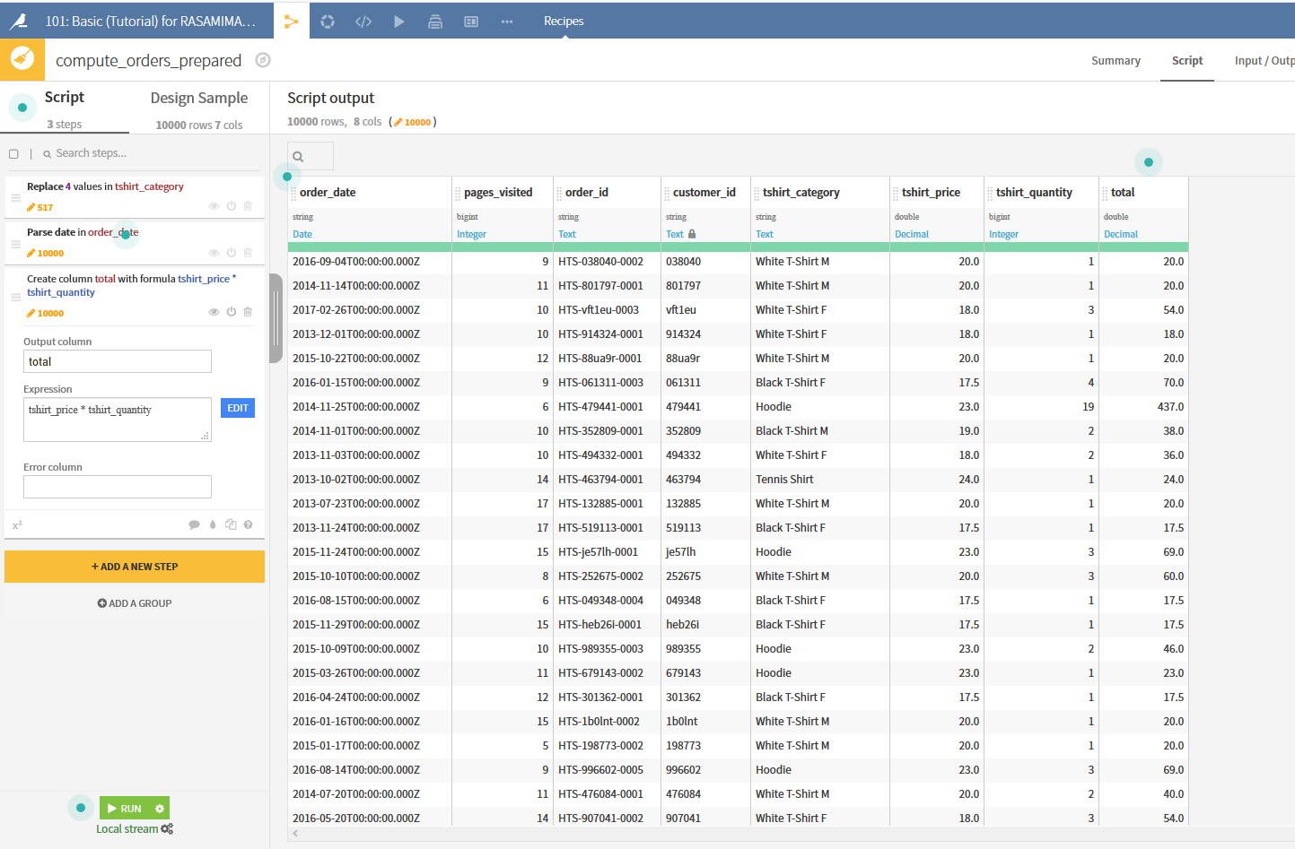
Tutorial Basics: Prepare Data with a Visual Recipe (7/9)
Type total as the name of the new column. In the expression, type tshirt_price * tshirt_quantity
Click anywhere and see the new total column appears

Slide 41
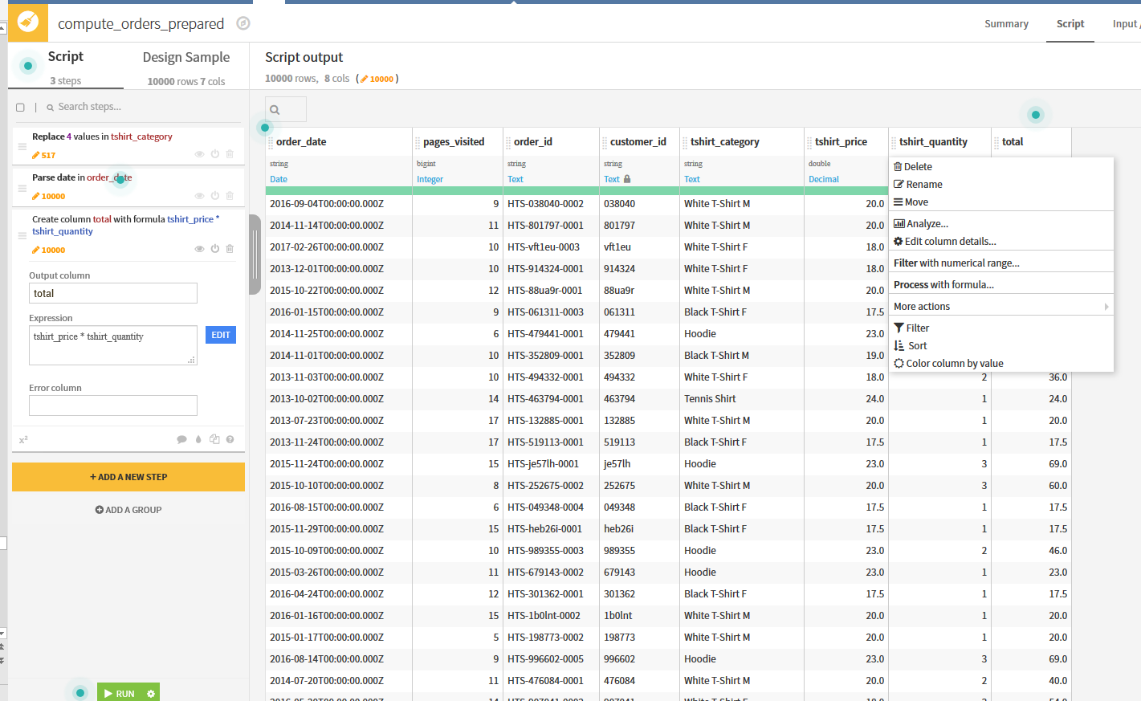
Tutorial Basics: Prepare Data with a Visual Recipe (8/9)
Delete the price and quantity columns. Click on the column header and choose Delete
Now you can run the recipe, for that click on Run on the lower left corner of the page.

Slide 42
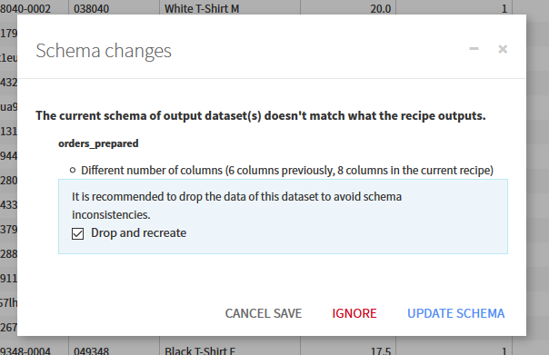
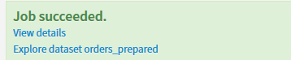
Tutorial Basics: Prepare Data with a Visual Recipe (9/9)
You will be asked to update the scheme, so you need to allow Dataiku DSS to update the schema
When the job completes, click Explore dataset orders_prepared to visit the output dataset.

Slide 43
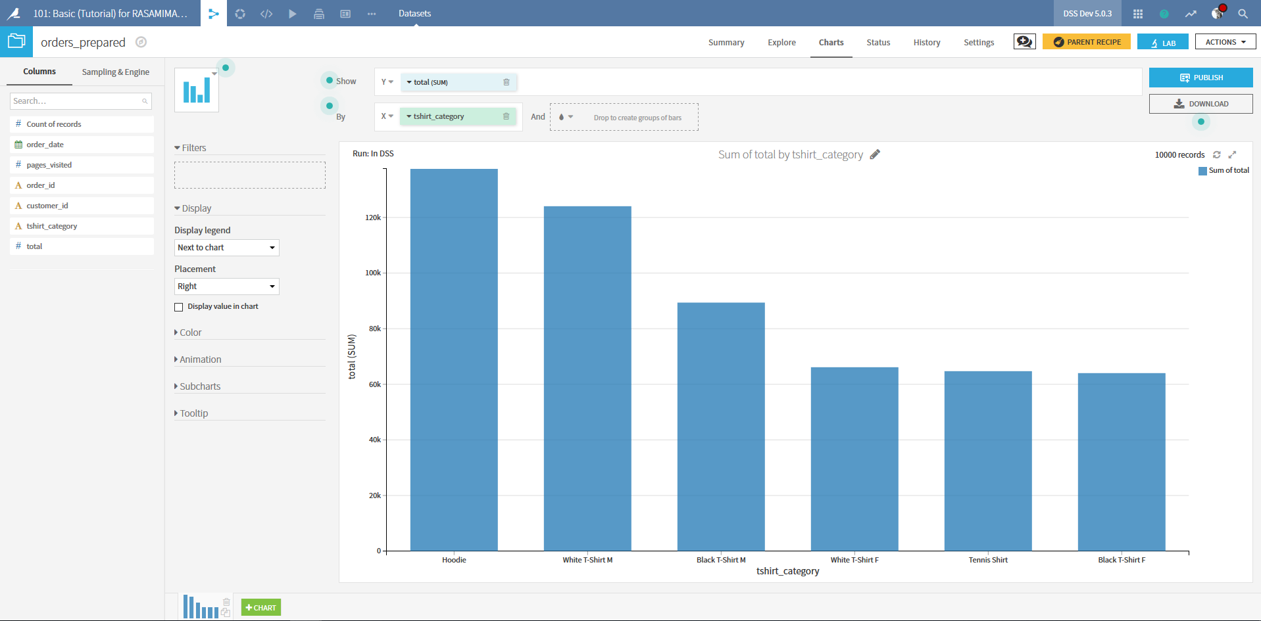
Tutorial Basics: Explore the output dataset (1/2)
At the end, we can create to see which categories of t-shirt are most popular. For that go to the Charts tab. Select total as the Y variable and tshirt_category as the X variable.

Slide 44
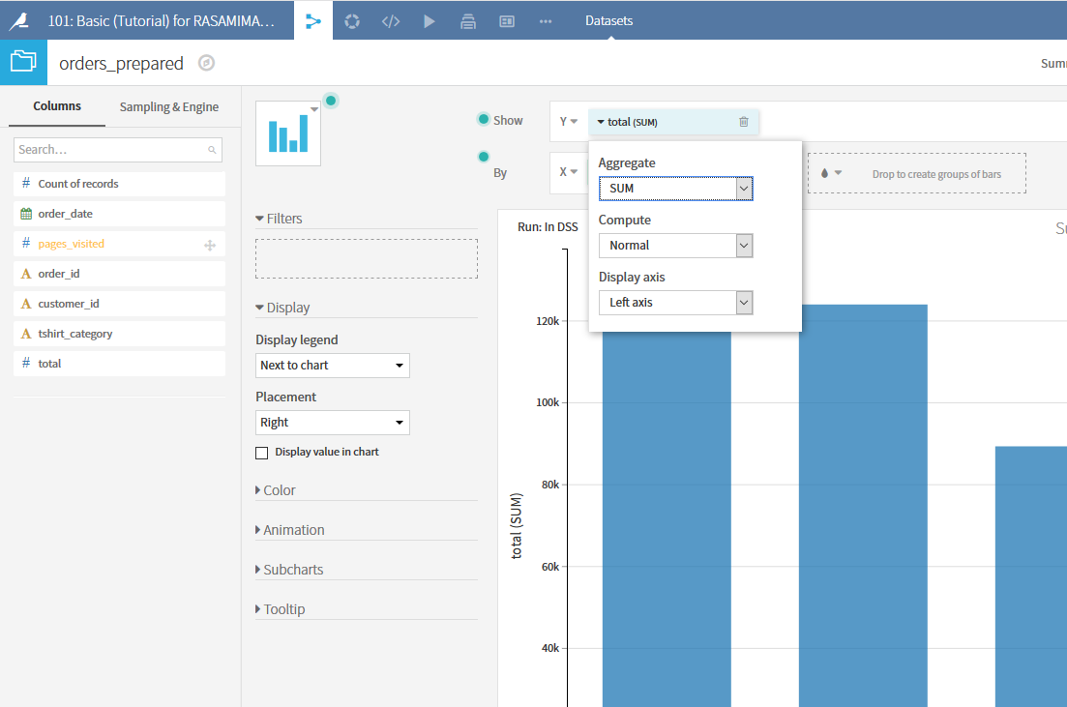
Tutorial Basics: Explore the output dataset (2/2)
Open the total dropdown and choose Sum as the aggregation. This changes our perspective. While each order for tennis shirts is relatively valuable, there are relatively few orders for tennis shirts. Hoodies and male t-shirts are more commonly ordered and the total value of those orders exceeds that of tennis shirts.

Slide 45
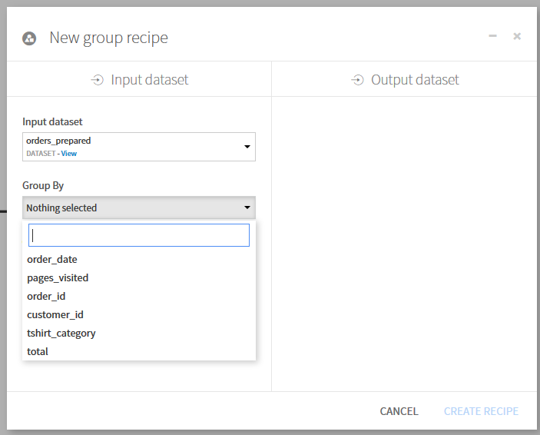
Tutorial Basics: Group Orders by Customer (1/3)
We want to group all past orders by customer, aggregating their past interactions.
With the orders_prepared dataset open, look in the upper-right corner for the Actions menu. From this menu, choose Group in the list of Visual recipes. The Group Recipe allows you to aggregate the values of some columns by values of one or more keys.
Choose to group by customer_id. Change the name of your dataset to orders_by_customer. Click Create Recipe

Slide 46
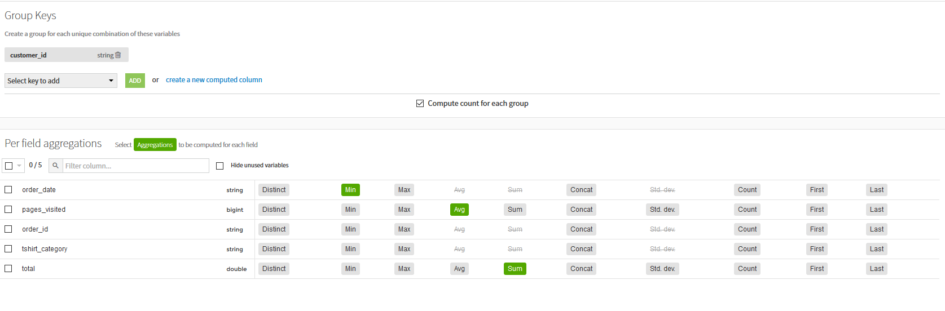
Tutorial Basics: Group Orders by Customer (2/3)
The Group Recipe has several steps (on the left). The core step is the Group step, where you choose which columns to aggregate and what aggregations you want performed.
Some columns, like order_id we won’t need in the new dataset. For the others make the following selections:
Order_date: Min => first date at which a customer ordered
Pages_visited: Avg => average number of visited pages by visit
Total: Sum => sum of all orders of the customer

Slide 47
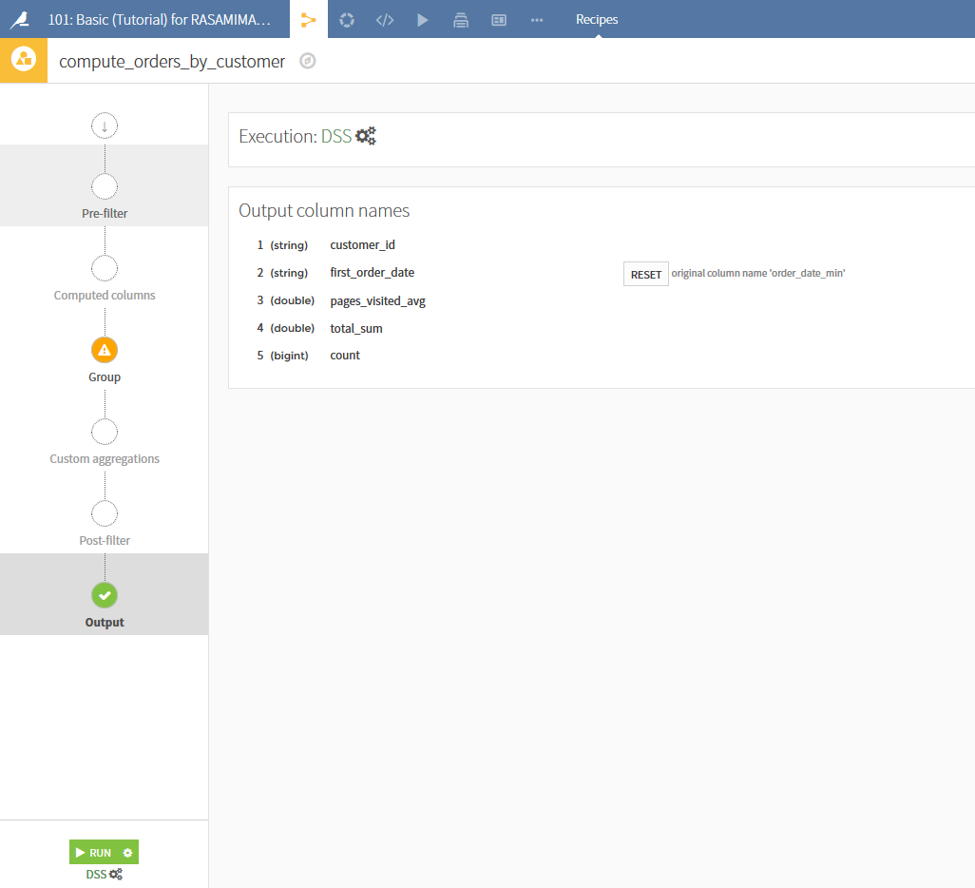
Tutorial Basics: Group Orders by Customer (3/3)
In the output step, you can select to rename the output columns. Let’s rename order_date_min to first_order_date
Click Run to create the new grouped dataset, then Explore the new dataset once run is complete

Slide 48
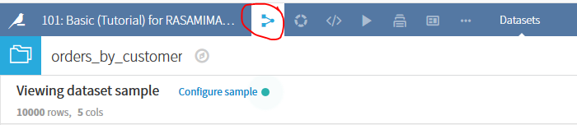
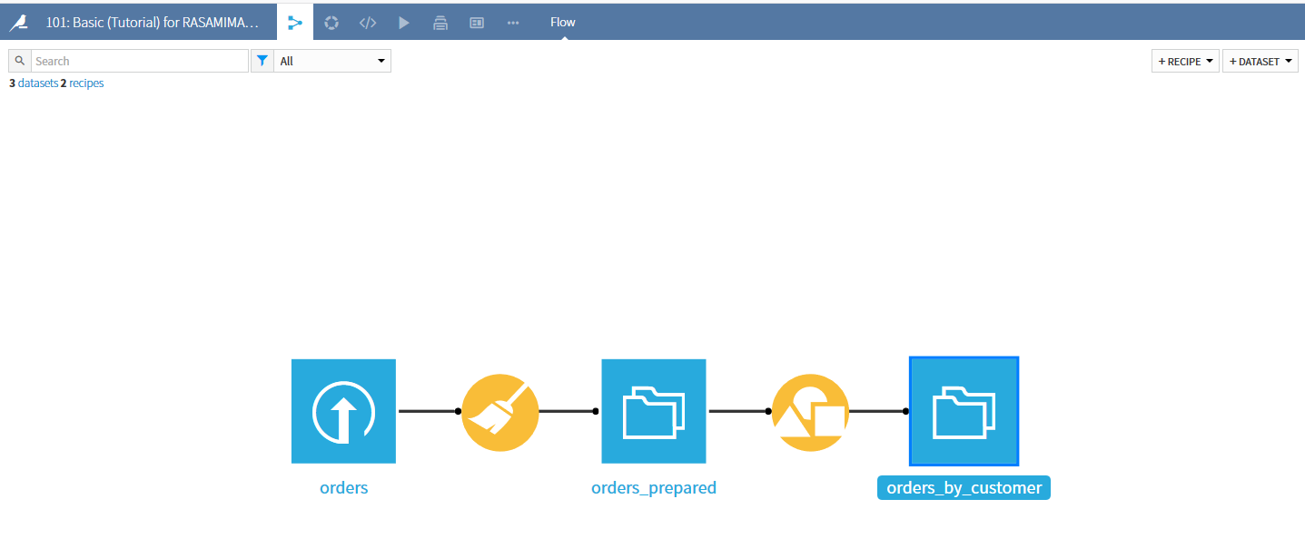
Tutorial Basics: Explore the Flow
Click on the flow icon next to the project name at the top of the page go to the project Flow. It is a visual representation of your project pipeline. You can see the preparation recipe followed by the Group Recipe followed by its output dataset.

